Slide 1
AUTONOMOUS IMAGE RECOGNITION
for
BEACH DEBRIS CLEANUPS
Contributors:
Bryan Flores
Monica Chao
Serina Robles

Slide 2
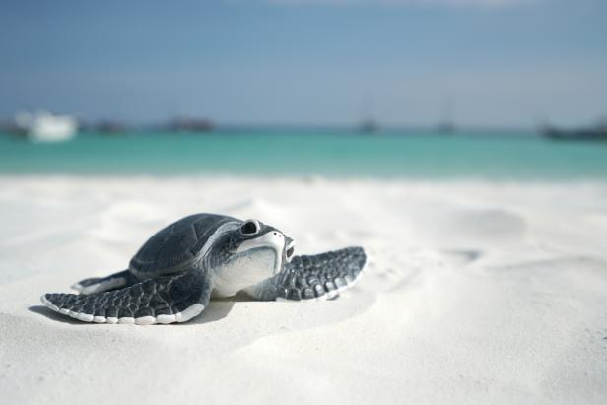

Motivations
Marine debris a persistent problem
Serious threat to marine species
Human involvement is limiting
Apply machine learning algorithm for autonomous machines to clean beaches on a more consistent basis
Notes:
Marine debris is a persistent problem that is only becoming worse. Beach cleanups are no longer a viable long-term solution. Not only is it a threat to human beings, but marine debris has negatively impacted marine species to the point of inadvertent ingestion, entanglement, and death.
We look to apply a machine learning image recognition algorithm using the fast.ai library for coastal cleanup applications, i.e. robotics and/or other autonomous machines.

Slide 3
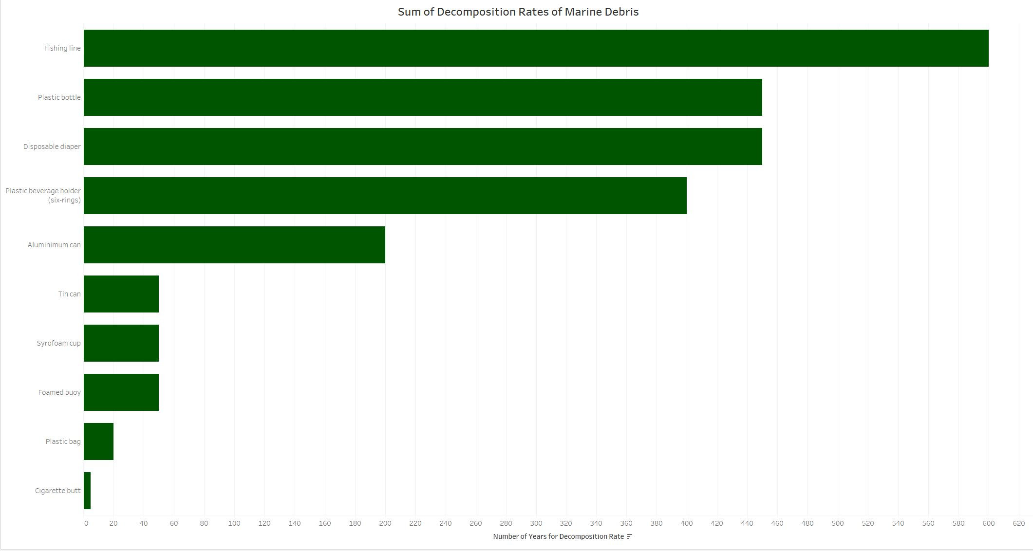
Debris Effects
Most debris can take hundreds of years to decompose.
Leads to how we need to prioritize debris type.
https://ourworldindata.org/plastic-pollution

Slide 4
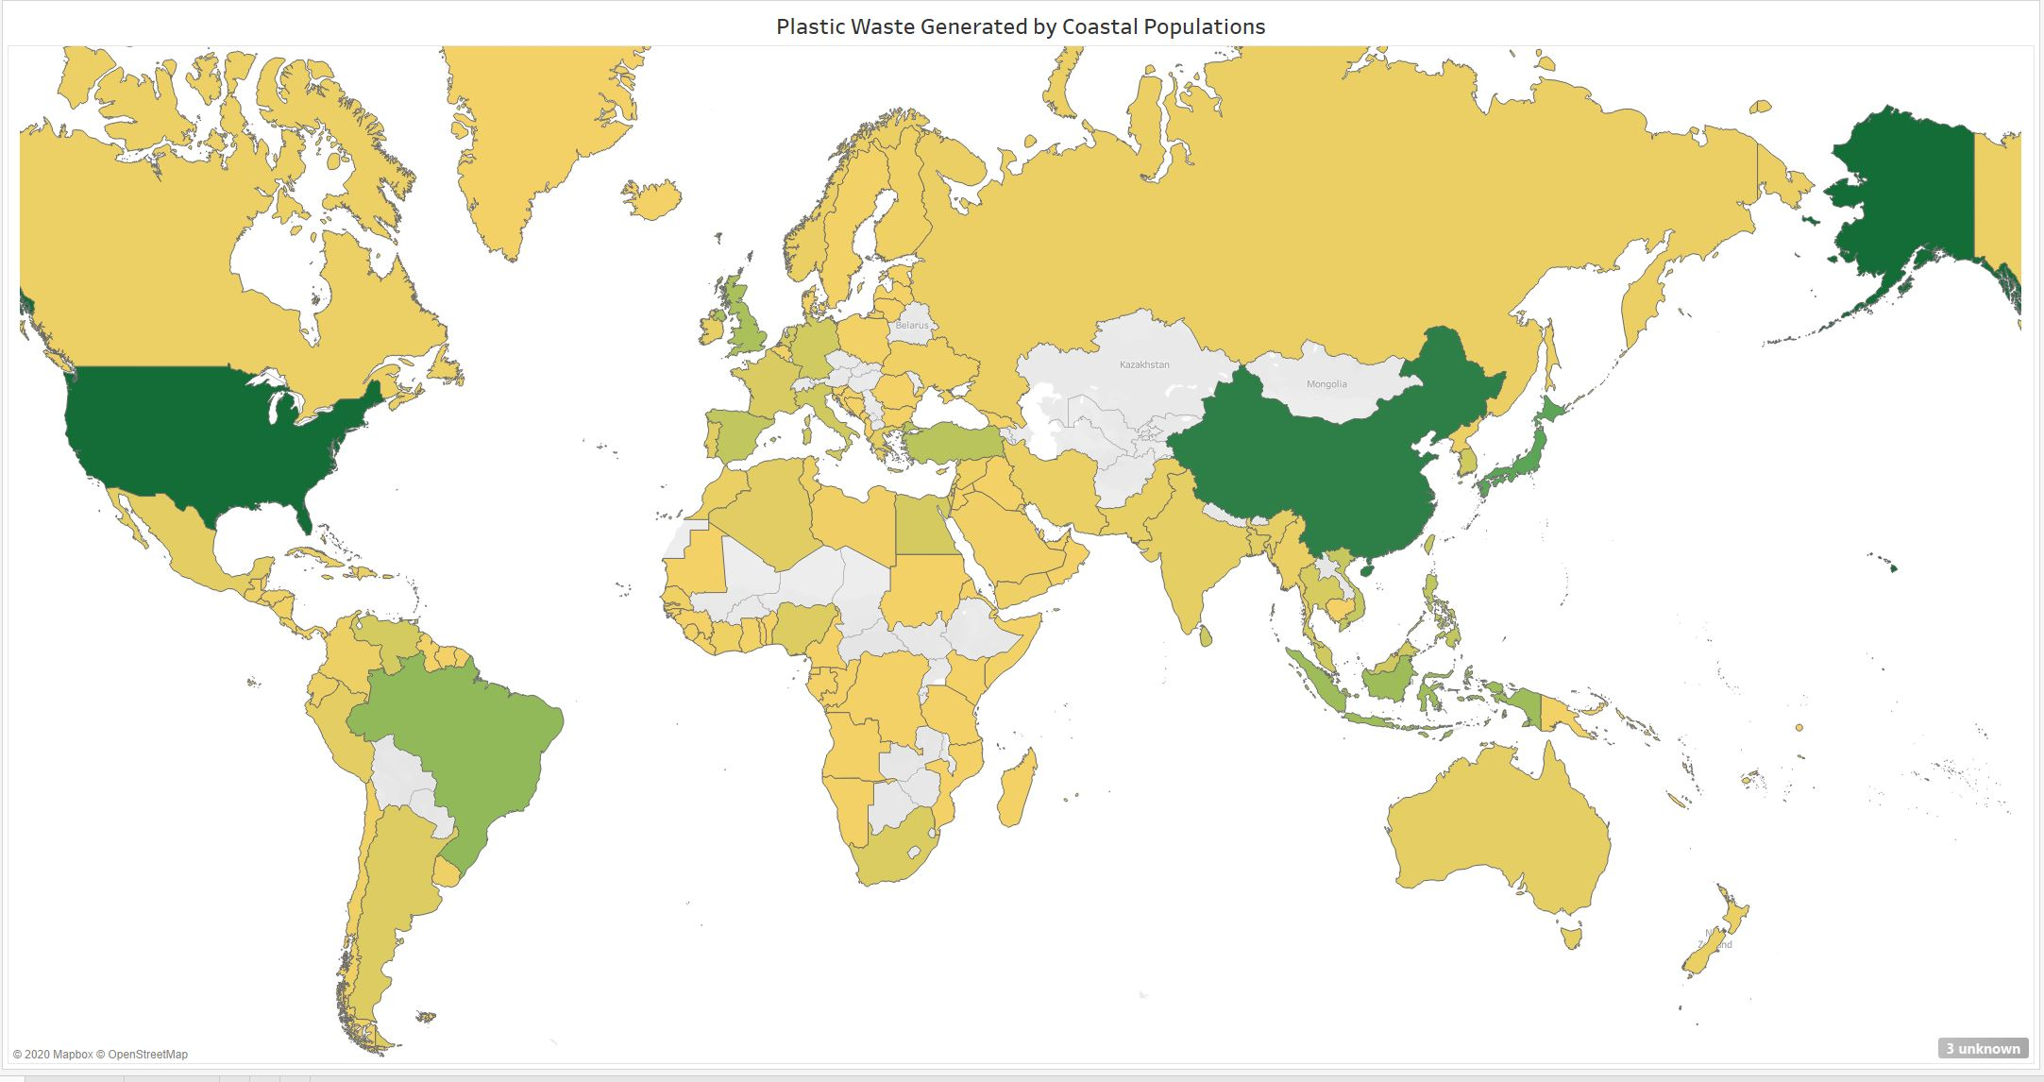
Marine Debris Problems
Plastic waste generated by coastal populations.
The colors correlate with the amount of waste that is generated by each coast per year in tons.
With Guernsey being the lowest at 141 tons and the United States with the highest at 37,729,383 tons.

Slide 5
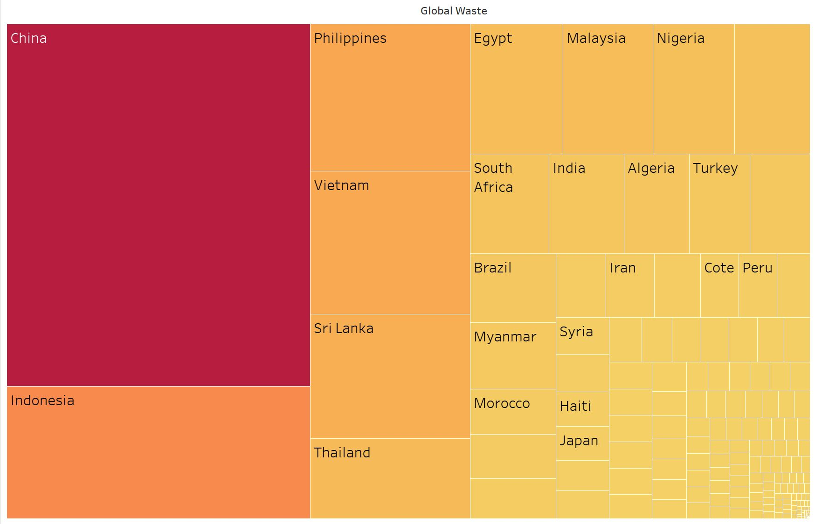
Share of Global Mismanaged Waste
The sum of mismanaged litter or inadequately disposed waste globally.
With Montserrat and Tokelau as the lowest waste producers at 0.0001%.
And China as the leading producer of waste at 27.6966%.

Slide 6
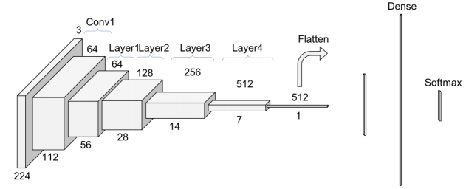
Convolutional Neural Network
Fast.ai → deep learning library to create neural network
ResNet-34 neural architecture
Learns on 3000+ images of 6 debris types:
Cardboard, Plastic, Metal, Glass, Trash, Paper
To be trained on images of polluted beaches and coastal species
ResNet-34 architecture

Slide 7
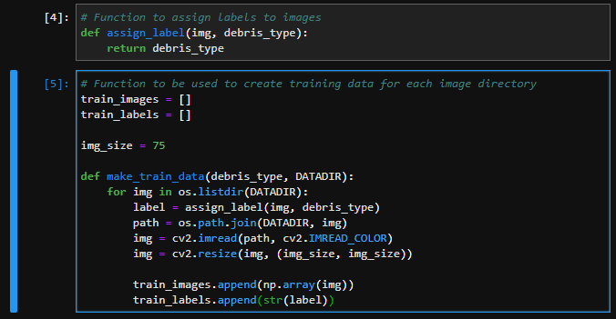
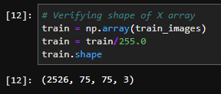
Creating Training Data
Function to create training data for each image directory (at left).
Verifying the shape of the training array (below).
Notes:
When creating the training data, we created 2 functions. 1 to assign labels to each image and the second to pull the images from the data files to an empty. Snippet to the right shows the shape of the training array.

Slide 8
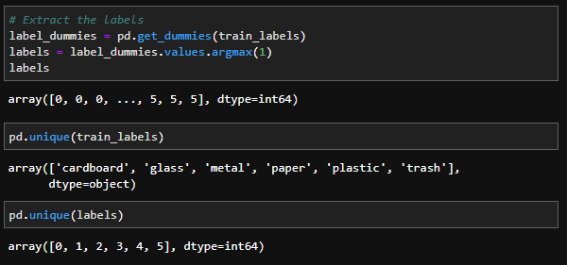
Extracting & Applying Labels
Notes:
First, we define each unique label as an integer. Then, we print each unique label and their respective integer. Cardboard is 0, glass is 1, etc.

Slide 9
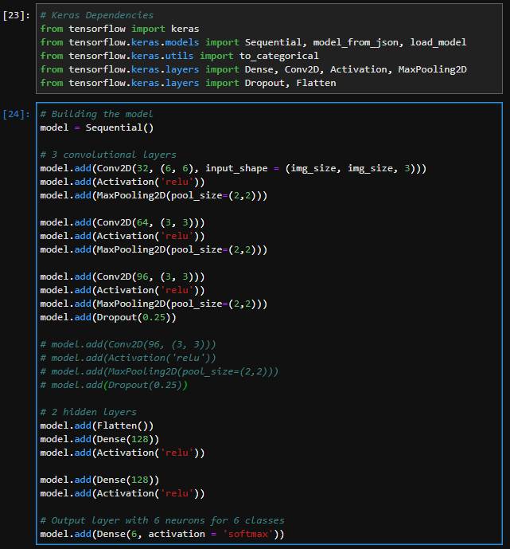
Keras Neural Structure
Notes:
Initially we created a neural network using Keras with 3 convolutional layers and 2 hidden layers.

Slide 10
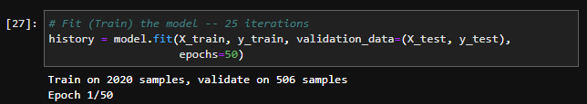
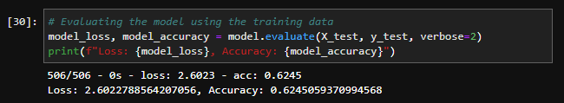
Comparing with TensorFlow & Keras
62.5% Accuracy with TensorFlow & Keras
Notes:
We were only able to reach 62.5% accuracy using TensorFlow & Keras. This is likely due to limited size of the data set and/or the complexity of the neural architecture. Which gives way to benefit of using the fast.ai library, discussed previously. The fast.ai library applies the resnet-34 architecture on the data given, which is much more complex and refined than the one created with Keras.

Slide 11
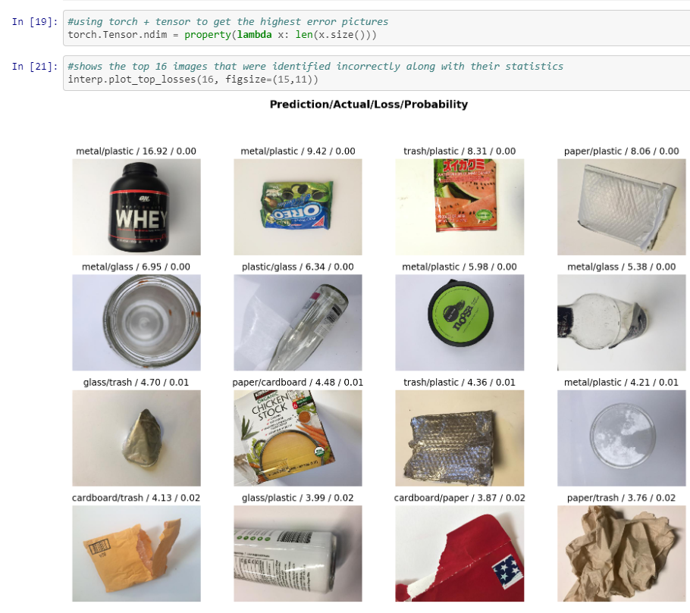
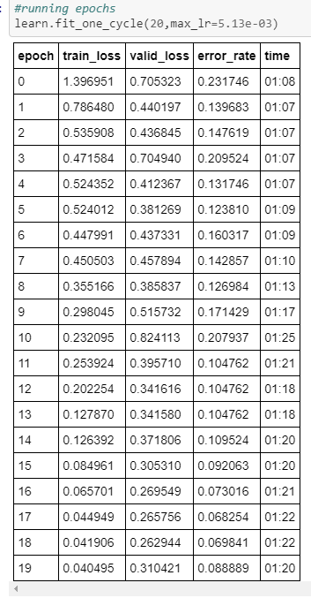
Training
Error rates decrease as more epochs are ran. Keep in mind that only 20 epochs were ran for this!

Slide 12
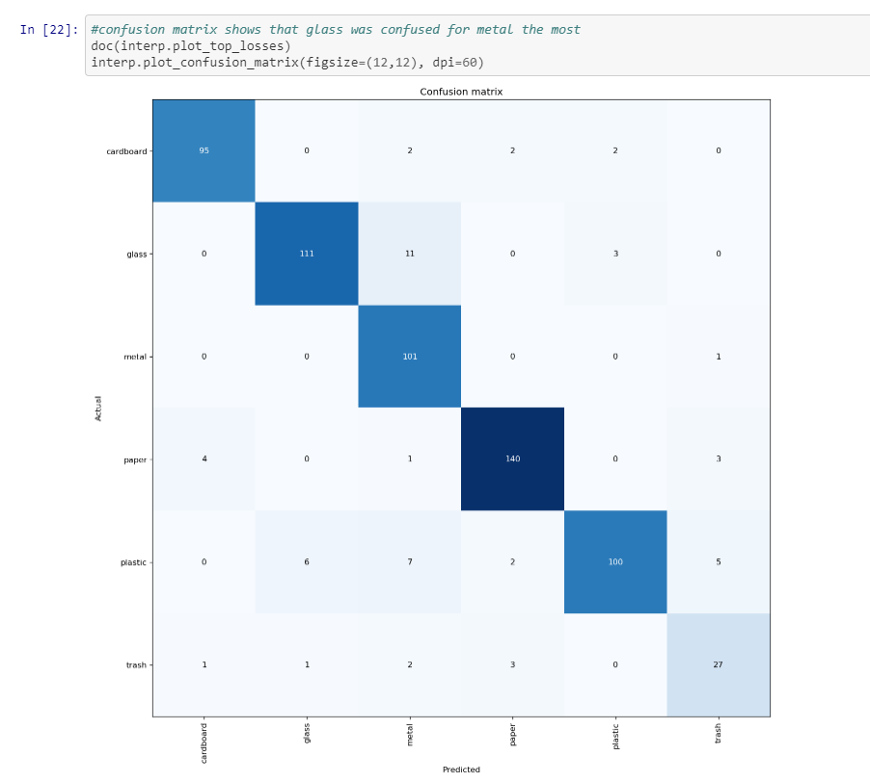
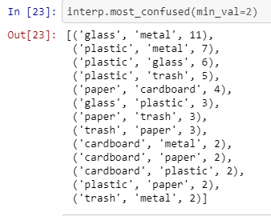
The confusion matrix shows the categories that the machine had the most trouble identifying;
Glass was confused for metal and plastic was confused for metal often in this case

Slide 13
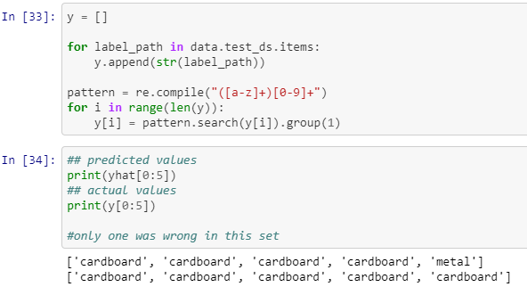
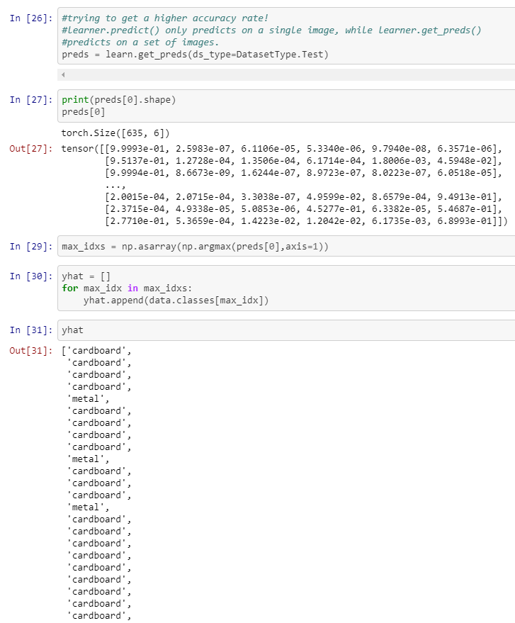
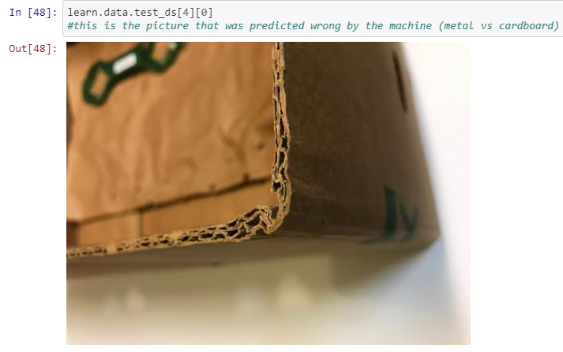
Predictions on Test Data

Slide 14
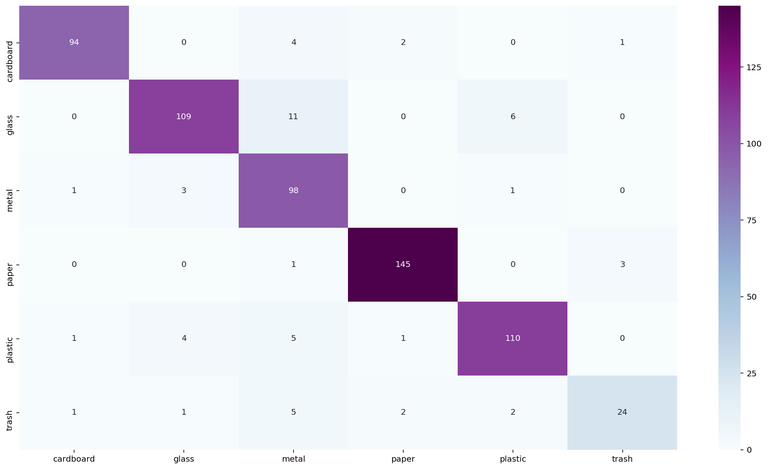
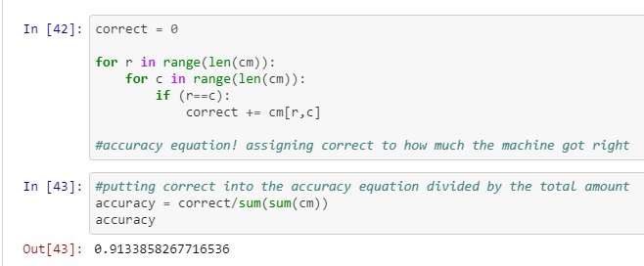
Test Data Confusion Matrix
The machine still seems to have trouble differentiating metal vs glass but improved on metal vs plastic compared to the previous matrix (training data). We were able to get a
91.34% accuracy rate.

Slide 15
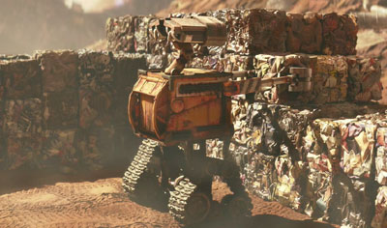
Conclusion
ResNet architecture over human built architecture
Good foundation for debris collection application
Next? Object recognition
Notes:
The ResNet neural architecture allows the model to decipher images with significantly higher accuracy than the TensorFlow/Keras library.
Though the model had issues differentiating metal vs glass, we believe this is a good foundation for an autonomous debris collection machine.
Further work will be to train the model on deciphering objects from broader and quicker scans of its environment to avoid any damage to the ecosystem it is working to protect.

